Slide 1
SQUANDER
FALL 2022 CAPSTONE PROJECT | PROF HENRY WONG
Aakansha Agarwala
Austin Blaise
Nicholas Wong
Rajat Nagavkar
Suryadeep Nallana

Slide 2












AGENDA
Team Members
Product Backlog
Project Overview
Sprint Backlog
Personas
Retrospective
Technologies
Future Sprint
Design Architecture
Project Demo
Sprint Overview
Conclusion

Slide 3

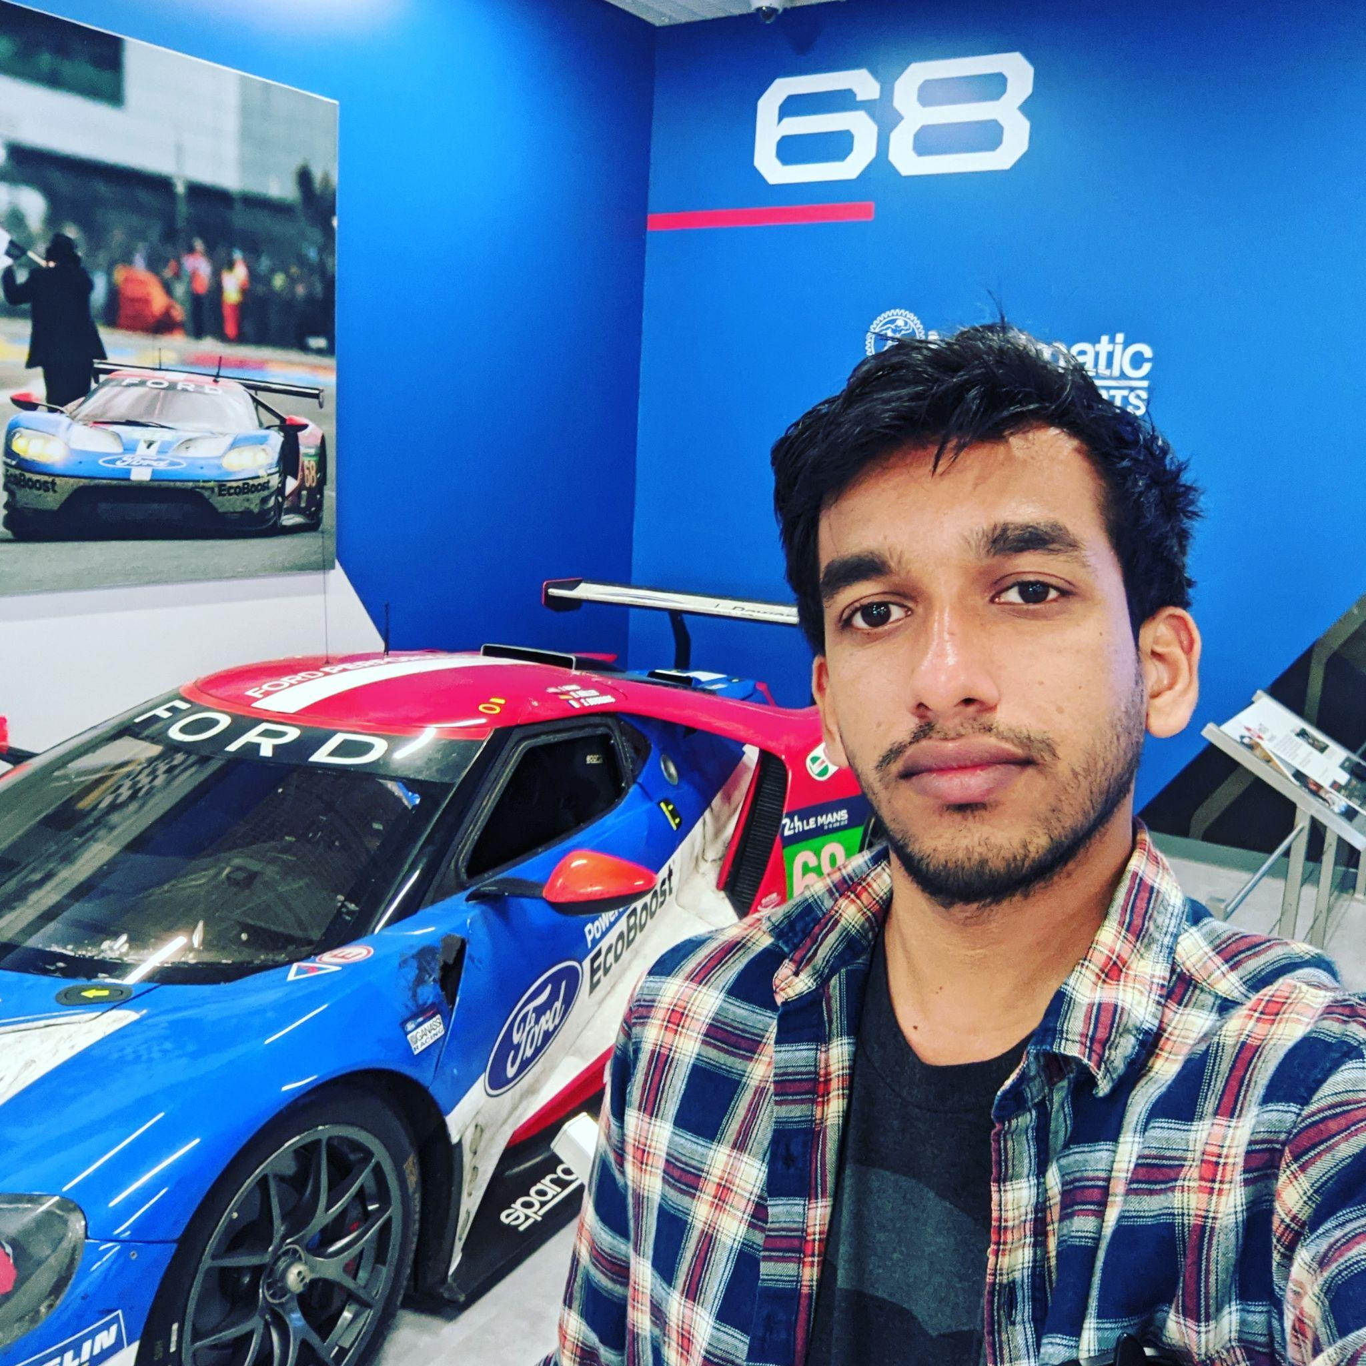
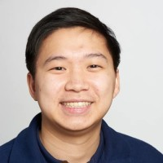
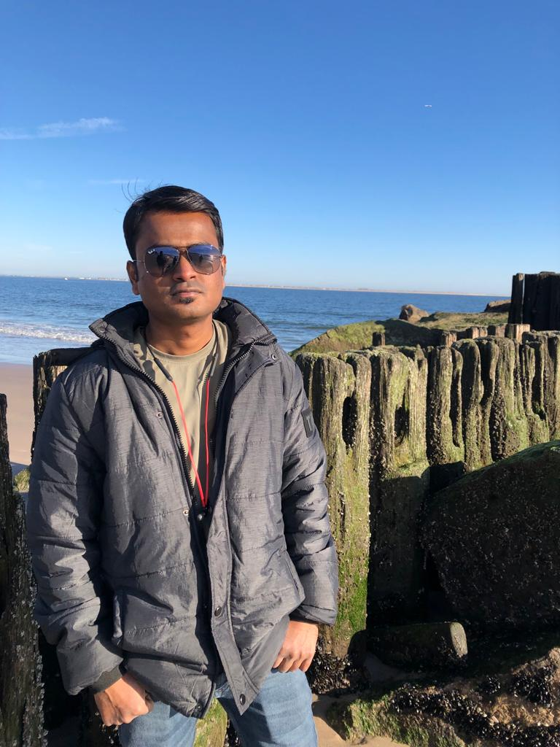
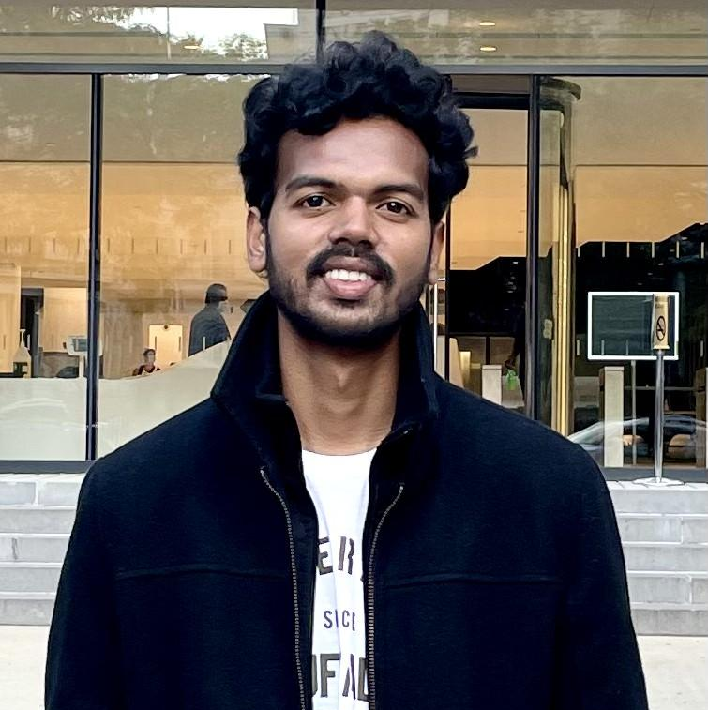
Aakansha Agarwala: Project Manager/Scrum Master
1. Led team meetings and kept the team on task
2. Maintains the project’s GitHub repository and Wiki
3. Documented test cases and co-authored technical paper
Austin Blaise: Cloud Engineer
1. Contribute to the architecture of the project
2. Creates Infrastructure as code
3. Integrated features and services
TEAM MEMBERS:
ROLES
AND
RESPONSIBILITIES
Nicholas Wong: Machine Learning Engineer
1. Design Computer Vision Model Architecture
2. Train and Evaluate Model Performance
3. Gather representative image data for training
Rajat Nagavkar: Ios Developer
1. Design and Development of Application.
2. Integrating ML model to provide specified results.
3. Testing the app to provide a better user experience.
Suryadeep Nallana: FullStack Developer/Quality Analyst
1. Contribution to design and development of the app layout
2. Authored technical document of the project
3. Working towards making our app user-friendly

Slide 4

PROJECT OVERVIEW

Slide 5

PROBLEM STATEMENT
As the population is increasing the amount of waste produced is also increasing.
The world produces 2.01 billion tons of urban solid waste yearly, with the United States being the highest producer of waste.
Most of the waste produced remains unprocessed due to a lack of recycling knowledge.
Squander app overcomes this problem by providing a way for waste recycling through a machine learning platform.

Slide 6
PROJECT DESCRIPTION
Squander app provides a complete solution to organize and plan the disposal of waste. It uses a machine learning algorithm to detect recyclable waste from images and provide proper disposal.
Squander app is an Image-based Waste detection mobile application.
The app works with an image submission by the user and a trained machine learning-based model runs on the image which gives results and information about that image.
As Squander is an image-based application, it’s an easy tool to detect waste by underlying simple steps in the application.
And the application also has a feature that provides the nearest recycling location with an option to schedule a pick of your waste by the recycling factory

Slide 7

PERSONA

Slide 8
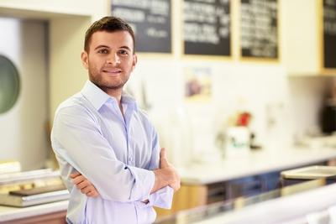
Jill, the party host
Background Profile:
Jill, a 32-year-old. He is an event organizer of a well-reputed company in the city. He has organized many big parties and is always busy with his job. He takes all the responsibility and his duties also include providing a good food service. He gets many clients, particularly for the food he provides. His organization is popular among the people Jill does many parties and he collected more food waste by the end of the party. Jill would like to know the waste identified from the image uploaded so that he can confirm the photo he uploaded was processable.
How can Squander help?
Jill being responsible for organizing the party. He wants to recycle all the waste by segregating in rightful manner and help the surrounding environment. He can use an application. Squander which provides his needs by showing the results of nearest recycling company location for all the food waste from his parties that happen wherever in the city. Squander makes an efficient and easiest way in someone’s life like Jill’s

Slide 9
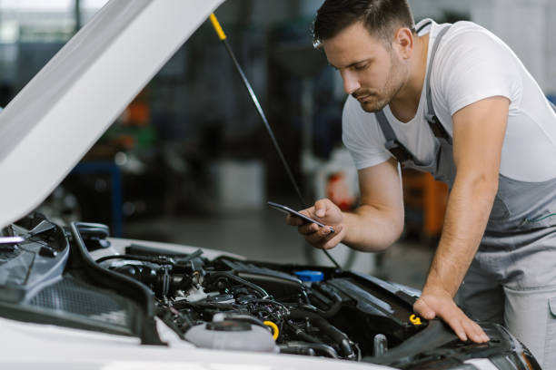
Simon, the mechanic
Background Profile:
Simon is a mechanic for ten years. His age is of 35 years. His jobs is to inspect and repair vehicles, machinery, and light trucks. And he is known for his good service providing for his customers. He works in an indoor garage. Simon’s culminated with metallic waste from his work and he wants to find a recycling location to recycle it and make some money from scrap
How can Squander help?
Simon can use the Squander application that helps him to find the nearest recycling company location for the waste to recycle from the comfort of his garage. This would allow him to find and provide easy access directly to the recycling company. He doesn’t have to worry about the waste and where to recycle it. Through Squander it makes his life easier.

Slide 10

David, the retiree
Background Profile:
David was a sale executive in a marketing firm. He retired from the job recently. He was successful and has been an inspiration for others in the company. After his retirement, David brought up the interest he had for quite some time to renovate his house. He wants to give a personal touch to the house and lead the rest of his life happily in his way. Now he is spending all his time taking care of the process under his supervision and making a beautiful house for himself
How can Squander help?
Squander can be helpful for David, as he is looking after the construction works for his house. The waste can generate a lot, with all the accumulated waste, he can recognize the waste under categories within the app and send it to his nearest garbage station. That’s make David being responsible for his waste and keeping the environment at a better position.

Slide 11

MINIMAL VIABLE PRODUCT

Slide 12
MINIMAL VIABLE PRODUCT (MVP)
Features:
Map integration with nearby recycling factory locations
Scheduling the pick up of recycling waste by the factory
Creation of a User Profile for each user who uses the application
Showing the History of a pickup that is scheduled by a user
Showing the recycling statistics for each user

Slide 13

TECHNOLOGIES

Slide 14







TECHNOLOGIES USED
AWS Cloudformation

Slide 15

ARCHITECTURE DESIGN

Slide 16
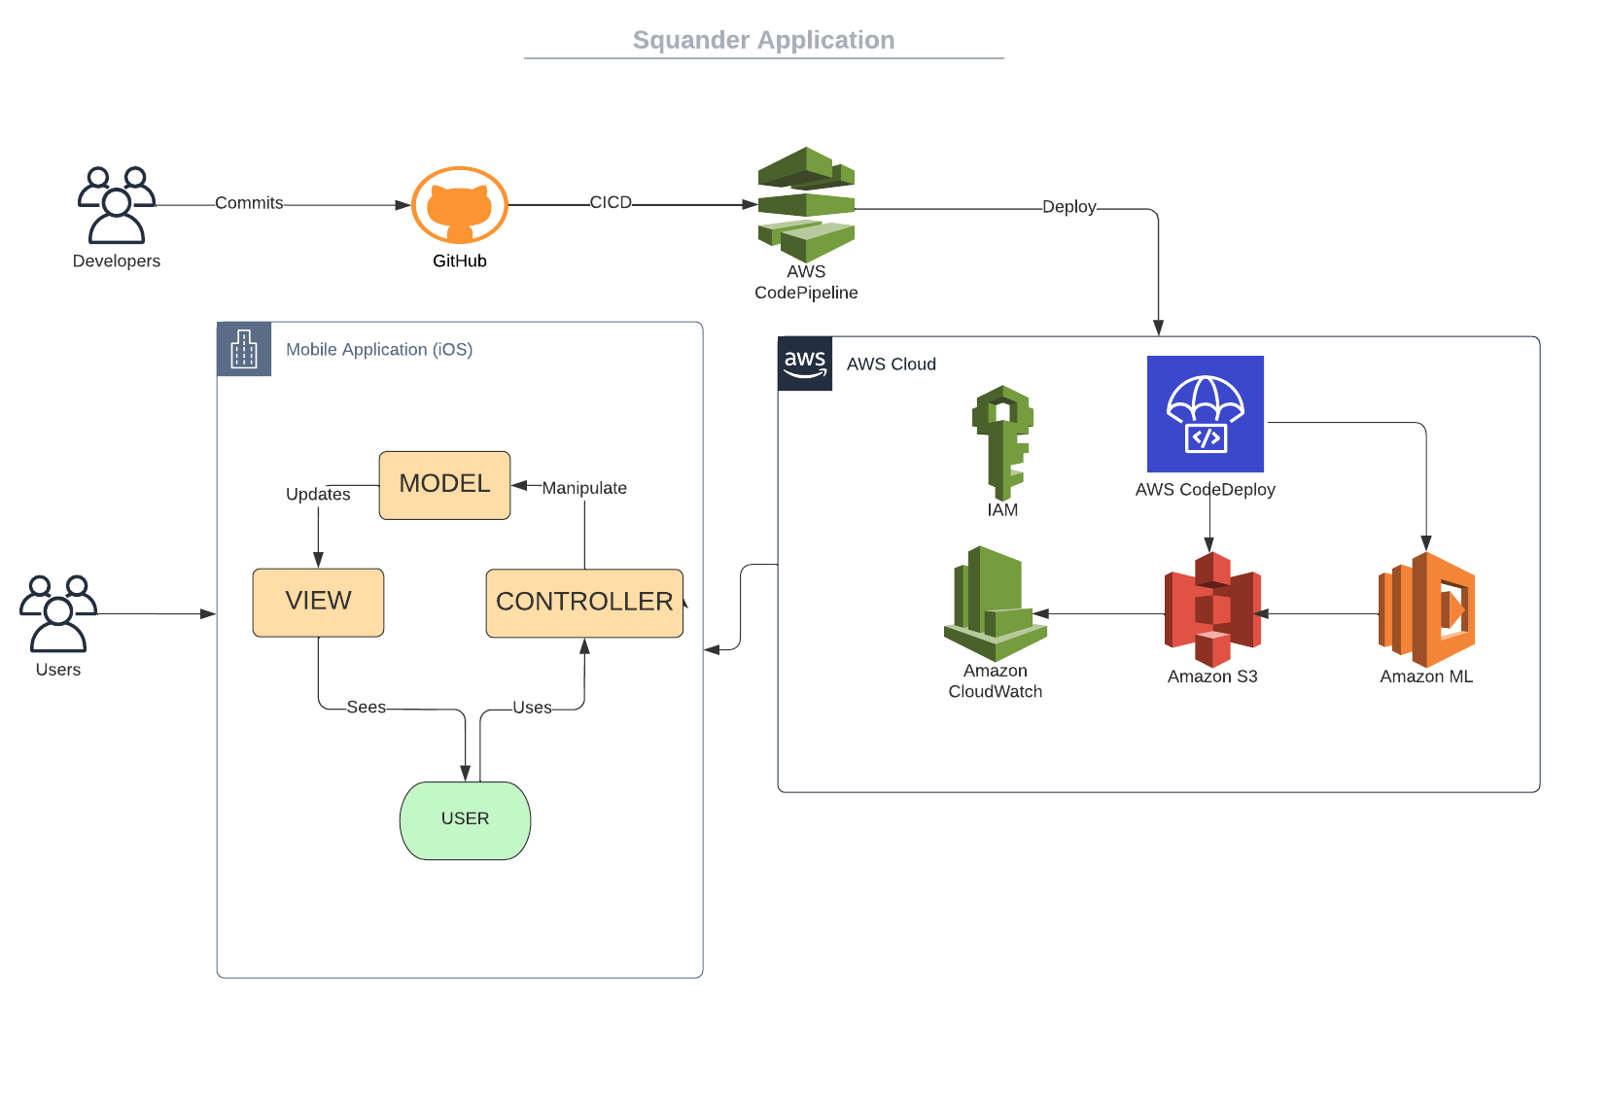
SQUANDER ARCHITECTURE

Slide 17
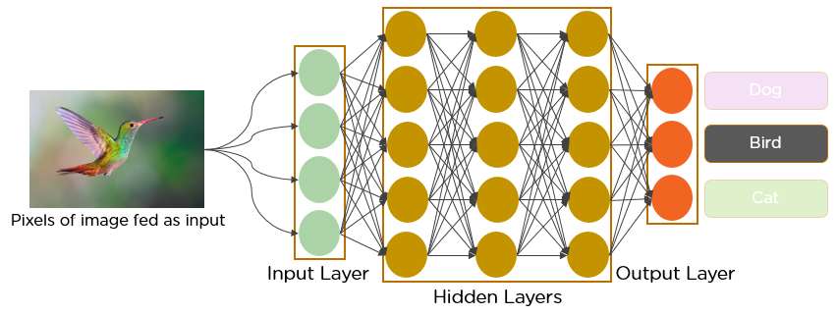
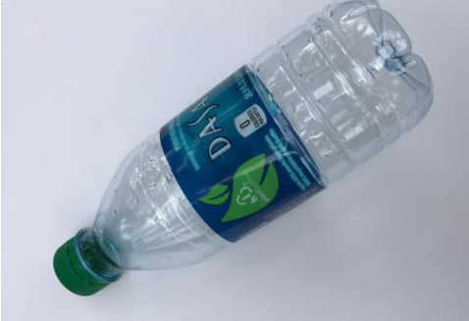
MACHINE LEARNING ALGORITHM
Plastic
Cardboard
Trash

Slide 18
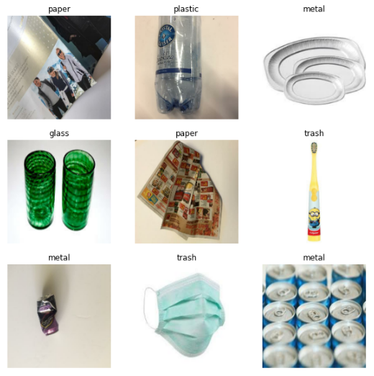
MODEL CLASSIFICATION
The model is able to classify trash into the following categories:
Cardboard
Glass
Metal
Paper
Plastic
Miscellaneous Trash

Slide 19
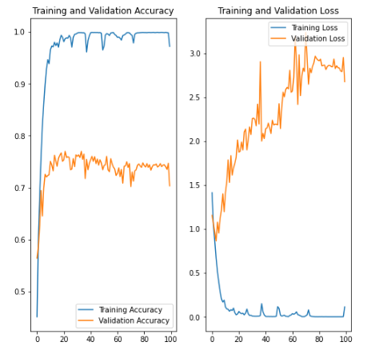
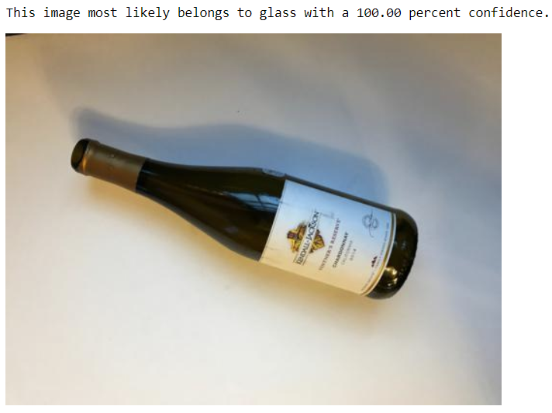
MODEL EVALUATION

Slide 20
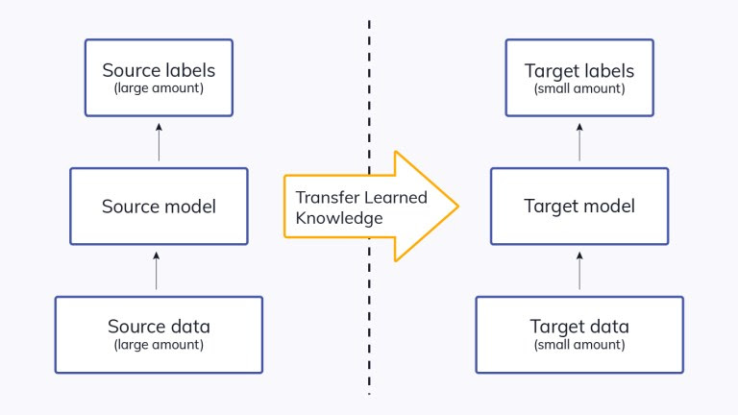
Transfer Learning
To alleviate the need for more images due to lack of public resources
Leverage a pre - trained model with a large amount of training data.
Fine tune the existing model.

Slide 21

SPRINT OVERVIEW

Slide 22
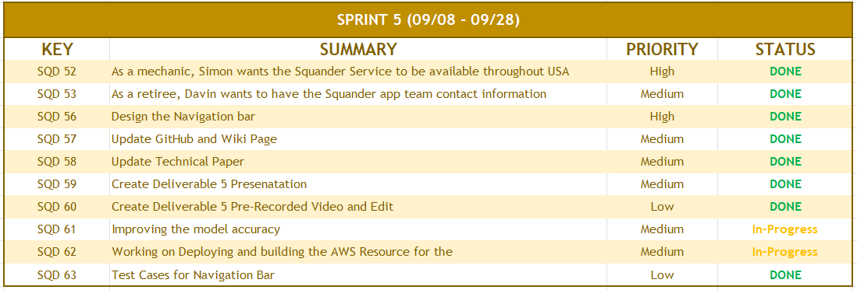
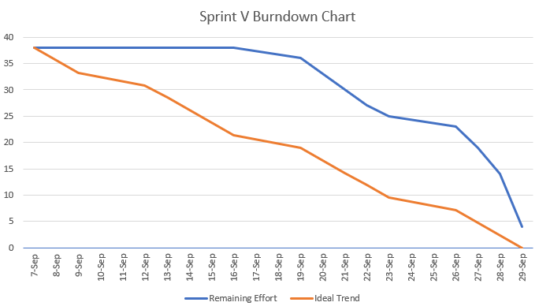
SPRINT 5 RECAP

Slide 23
SPRINT 5 vs SPRINT 6
SPRINT V | SPRINT VI
Determined and mapped out goals for future deliverables. | Recycling Location Feature is added
Navigation Bar feature is added in our application | Map View of Recycling Location is added
Model confidence value improved | Model confidence value improved from Sprint 5
Researched necessary technologies to achieve our goals | Automatically load all relevant recycling locations once the image is selected based on it waste type

Slide 24
Improvement From Professor Feedback
User Stories and Acceptance Criteria
Updated the User Stories and Acceptance Criteria Format in the correct format of Given When and then.
Velocity Chart
Updated the chart by adding one more column of ratio and calculated the average.
Minimal Viable Product
Updated the Minimal Viable Product slide with all the relevant points
Remove Project Requirement slides
The project Requirement slide is removed from the presentation deck
Slide placement
Updated the slide placement as per the checklist provided and made sure that we go in order.
Retrospective
Updated the Retrospective Slide with the actual meaning of the Retrospective in agile where we iterated that what went well as a team and what needs improvement, and tried to find a better resolution

Slide 25

BACKLOG

Slide 26
PRODUCT BACKLOG
KEY | SUMMARY | PRIORITY | SPRINT | STATUS
SQD 62 | Working on Deploying and building the AWS Resource for Squander | Medium | Sprint 8 | TO DO
SQD 61 | Improving the model accuracy | Medium | Sprint 6 | DONE
SQD 64 | As a retiree, David wants to Automatically load locations so that he can have a better user experience and easy to use application. | High | Sprint 6 | DONE
SQD 65 | As a homeowner, Mark wants to view details of the recycling location so that he can have a conversation with the company with any queries and know all the details of the working hour | High | Sprint6, Sprint 7 | In - Progress
SQD 66 | Design and Deploy AWS API Endpoint | Medium | Sprint 8 | TO DO
SQD 67 | As an engineer, John wants to view multiple recycling locations so that he can choose to navigate to one most accessible | HIgh | Sprint 6 | DONE
SQD 68 | Work on UI/UX and add more feature on Navigation Bar | Medium | Sprint 7 | TO DO
SQD 74 | As a mechanic, Simon wants to support a map view so that he can plan his route more intuitively | High | Sprint 6 | DONE
SQD 72 | As a homeowner, Mark wants to know about the Frequently Ask Question screen so that he can get answers to some of the commonly ask question. | High | Sprint 7 | TO DO
SQD 73 | As an engineer, John wants to schedule the pickup with the company so that he can be assured that his trash will be picked up. | High | Sprint 8 | TO DO
SQD 74 | As a mechanic, Simon wants to create his own account(User Profile) on Squander so that he can save his personal information like address, phone number, etc into the app for later use. | High | Sprint 7 | TO DO
SQD 75 | Redesign the UI/UX | Low | Sprint 7 | TO DO
SQD 76 | As a retiree, David wants to know his recycling statistics so that he knows how much he has contribution to saving the world from global warming | High | Sprint 8 | TO DO
SQD 80 | Optimize Squander Code | Medium | Sprint 8 | TO DO

Slide 27
SPRINT BACKLOG
SPRINT 6 (09/29 - 11/2)
KEY | SUMMARY | PRIORITY | STATUS
SQD 61 | Improving the model accuracy | Medium | DONE
SQD 64 | As a retiree, David wants to Automatically load locations so that he can have a better user experience and easy to use application. | High | DONE
SQD 67 | As an engineer, John wants to view multiple recycling locations so that he can choose to navigate to one most accessible | HIgh | DONE
SQD 74 | As a mechanic, Simon wants to support a map view so that he can plan his route more intuitively | High | DONE
SQD 85 | Update GitHub and Wiki Page | Medium | DONE
SQD 86 | Update Technical Paper | Medium | DONE
SQD 87 | Create Deliverable 6 Presentation | Medium | DONE
SQD 88 | Create Deliverable 6 Pre-Recorded Video and Edit | Low | DONE
SQD 89 | Update Installation Manual and User Manual | Low | DONE
SQD 91 | Test Cases for Sprint 6 | Low | DONE
SQD 65 | As a homeowner, Mark wants to view details of the recycling location so that he can have a conversation with the company with any queries and know all the details of the working hour | High | In - Progress

Slide 28
USER STORIES & ACCEPTANCE CRITERIA
ID | AS A | I WANT TO | SO THAT | ACCEPTANCE CRITERIA
SQ 67 | John, the engineer | View multiple recycling locations | I could choose to navigate to one most accessible | Given: John uploads image of the garbage or recyclables. When: John needs to find multiple recycling locations, Then: John is presented with multiple location, if available.
SQ 74 | Simon, the mechanic | Support a map view | I could plan my route more intuitively. | Given: Simon uploads image of the garbage or recyclables, When: He needs to view the recyclable locations, Then: Simon can choose map view
SQ 64 | David, the retiree | Automatically load locations | I have a better user experience and easy to use app. | Given: David be automatically redirected to recycling location, When: He they upload the image. Then: It’s easier for him to see all the nearby locations
SQ 65 | Mark, the homeowner | View details of the recycling location | I could have a conversation with the location and form relations. | Given: Mark has uploaded the image, When: He click on the Location, Then: Mark can have basic details of the company like address, working hours, etc.

Slide 29

TEST CASES

Slide 30
TEST CASES
Test Case Name | User Story | Test Case ID | Test Action | Expected Results | Test Result | Pass/Fail
Recycling Location | SQD-67 | SQD-92 | Locate the Recycle Location Link | Users should be able to see the Recycle Location link and it should be clickable | Once the user is on the About Us Screen, the recycle location link is visible, and once clicked on the button it redirects to the recycle location | PASS
 |  | SQD-93 | Locate Recycle Button | Choose the image to upload and then there comes the recycle button which is clickable | Once the user is on the result screen, recycle button is clickable | PASS
 |  | SQD-94 | Nearby Recycling Location List | User should be able to see a list of recycling location in the screen | Once the user click on the Recycle button, users can see a list if nearby recycling Location | PASS
 |  | SQD-95 | Locate the Back Button | User should be able to see the Back Button in the result screen | Once the user is on the Result Screen, the back button is visible, and once clicked on the button it redirects to the home screen | PASS
Map View | SQD-74 | SQD-96 | Google Map is visible | User should be able to see all the recycling location pinned on the Google Map integrated | Once user click on the list of recycling location list, all the recycling companies are pinned into the Google Map in the App | PASS
 |  | SQD-97 | Details of Pinned location | User when clicked on the pinned location in the Map show the recycling company name and details | Once user hover over the pinned location in the map, it shows user the recycling company name with its location | PASS
 |  | SQD-98 | Distance from your location | User should be able to see the distance from his home to recycling location | Once user click on any recycling location it shows the distance between the user location to the recycling location.i | PASS

Slide 31
STORIES COMPLETED
ID | AS A | I WANT TO | SO THAT | ACCEPTANCE CRITERIA
SQ 67 | John, the engineer | View multiple recycling locations | I could choose to navigate to one most accessible | Given: John is provided with multiple recycling location, to choose, When: He choose to garbage a type of waste, Then: John can select any one location to garbage.
SQ 74 | Simon, the mechanic | Support a map view | I could plan my route more intuitively. | Given: Simon is able to view the location on a Google Map view, When: He click on the view on map button, Then: simon can choose the route accordingly.
SQ 64 | David, the retiree | Automatically load locations | I have a better user experience and easy to use app. | Given: David be automatically redirected to recycling location, When: He they upload the image. Then: It’s easier for him to see all the nearby locations

Slide 32
STORIES NOT COMPLETED
ID | AS A | I WANT TO | SO THAT | ACCEPTANCE CRITERIA
SQ 65 | Mark, the homeowner | View details of the recycling location | I could have a conversation with the location and form relations. | Given: Mark is able to view basic details of recycling location, When: He click on the Location, Then: He can have all the details of the company like address, working hours, etc.
This is an In-Progress User Story which is spilled into Sprint 7

Slide 33
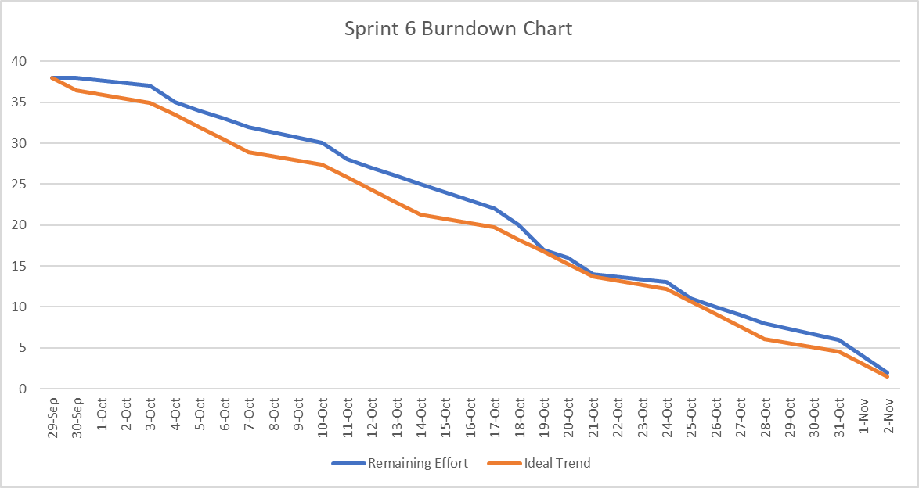
BURNDOWN CHART

Slide 34
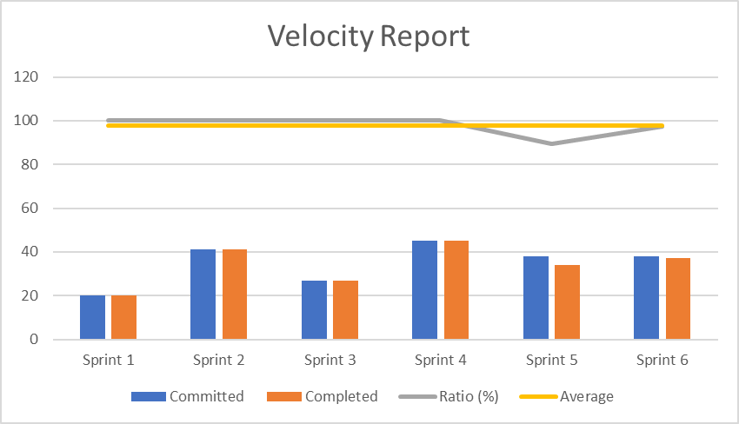
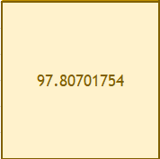
COMMITTED/COMPLETED RATIO
SPRINT | Committed | Completed | Ratio (%) | Average
Sprint 1 | 20 | 20 | 100 | 98.24561404
Sprint 2 | 41 | 41 | 100 | 98.24561404
Sprint 3 | 27 | 27 | 100 | 98.24561404
Sprint 4 | 45 | 45 | 100 | 98.24561404
Sprint 5 | 38 | 34 | 89.47368421 | 98.24561404
Sprint 6 | 38 | 37 | 97.36842105 | 98.24561404
Current Committed Completed Ratio (Sprint 6) = 97.4%

Slide 35

RETROSPECTIVE

Slide 36
RETROSPECTIVE
01
What went well
Improvements from feedbacks and continuous delivery
Adaption blockers went well.
02
What needs improvement
Estimation on Sprint capacity
Regular Sprint Meetings
03
Future Actions
Revisit Capacity estimation
Adjust with schedule and find common time

Slide 37

FUTURE SPRINT

Slide 38
SPRINT 7(NEXT SPRINT)
SPRINT 7 (11/3 - 11/16)
KEY | SUMMARY | PRIORITY | STATUS
SQD 65 | As a homeowner, Mark wants to view details of the recycling location so that he can have a conversation with the company with any queries and know all the details of the working hour | High | TO DO
SQD 68 | Work on UI/UX and add more feature on Navigation Bar | Medium | TO DO
SQD 72 | As a homeowner, Mark wants to know about the Frequently Ask Question screen so that he can get answers to some of the commonly ask question. | High | TO DO
SQD 74 | As a mechanic, Simon wants to create his own account(User Profile) on Squander so that he can save his personal information like address, phone number, etc into the app for later use. | High | TO DO
SQD 75 | Redesign the UI/UX | Low | TO DO
SQD 79 | Design Squander to be User Friendly | Medium | TO DO

Slide 39
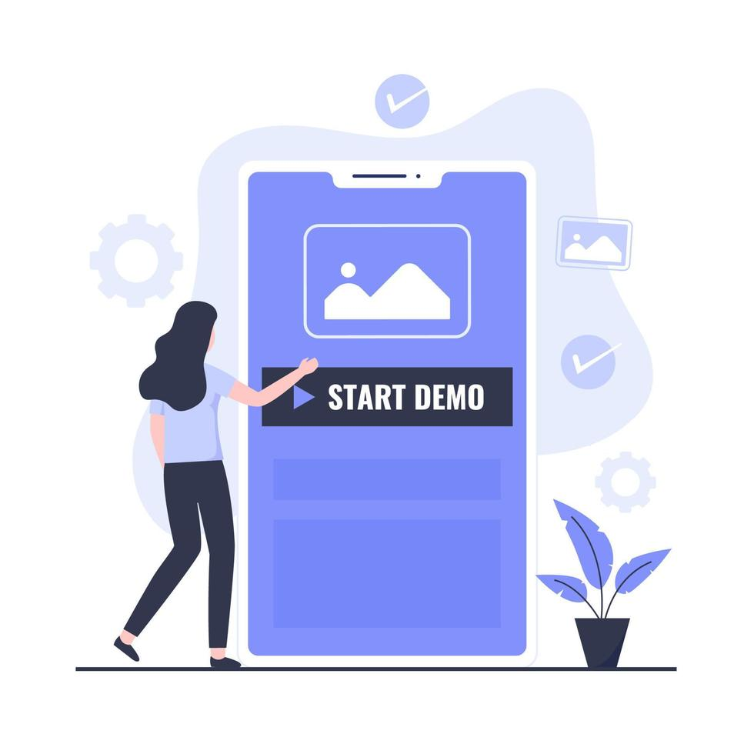
PROJECT DEMO

Slide 40
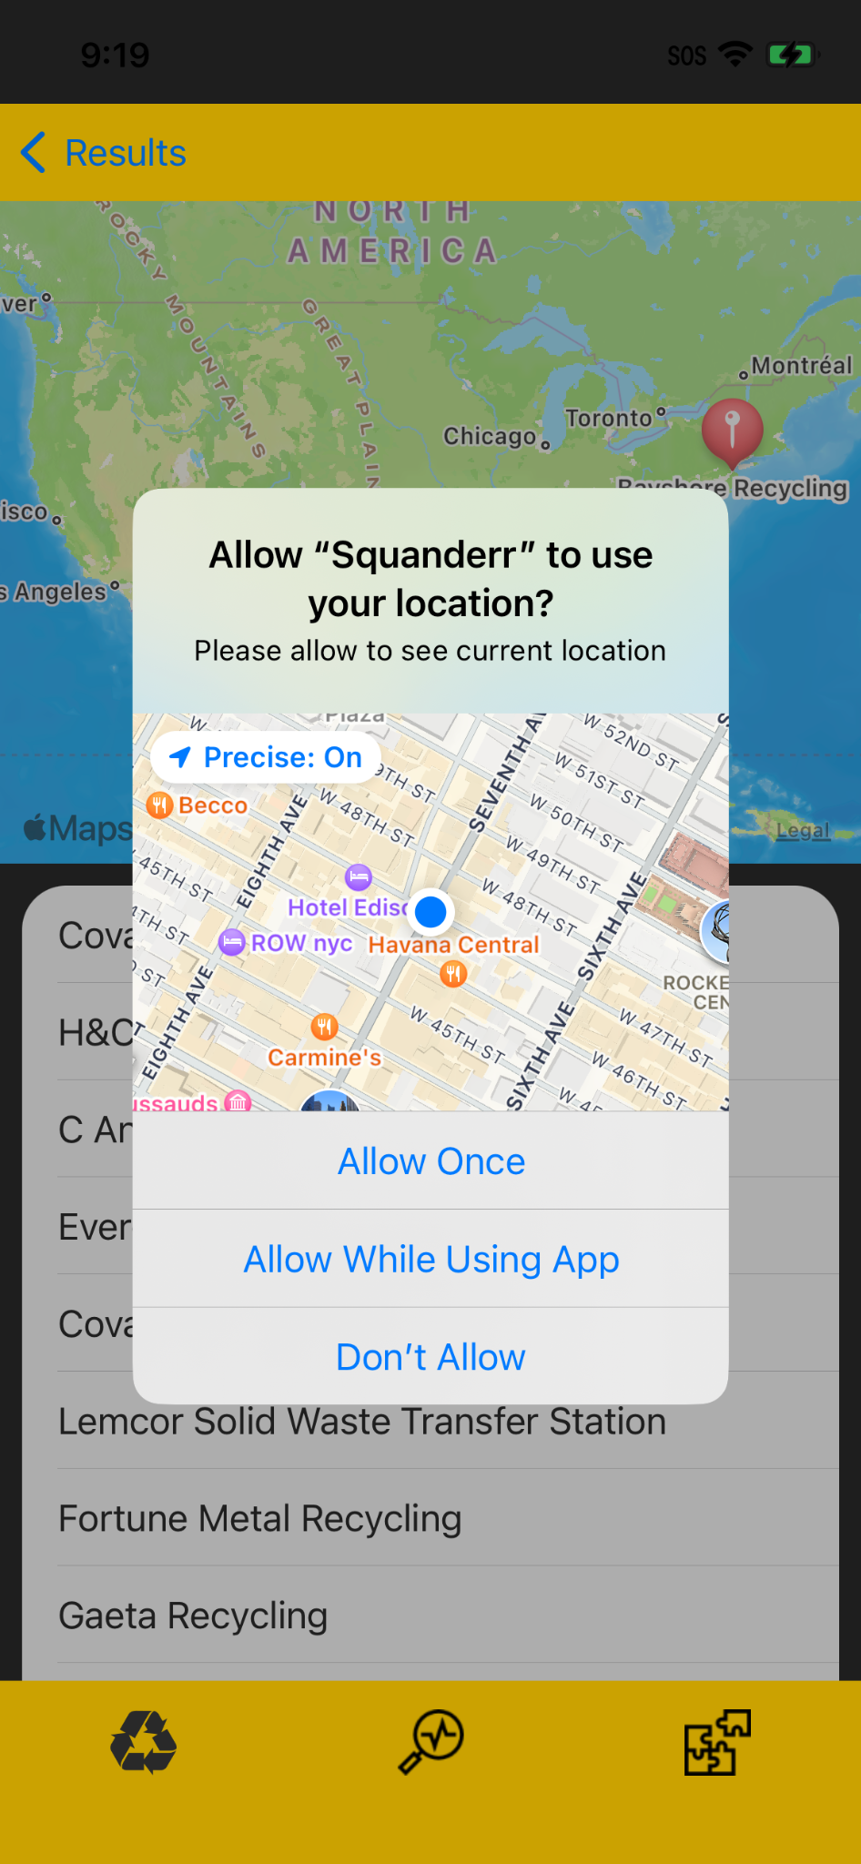
APP SCREENSHOTS
Recycling location screen..
Permission to Access User Location

Slide 41
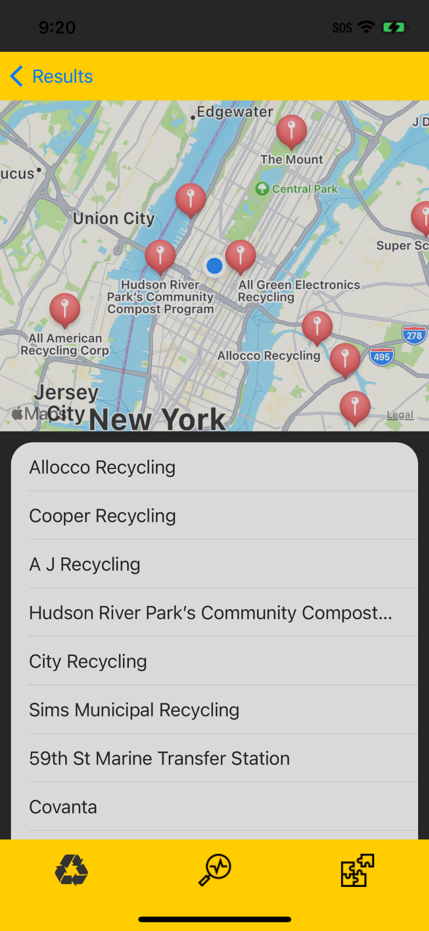
Continue..
Recycling location screen..
Showing current Location.
Nearby recycling location.
And list of recycling Company.

Slide 42


API
MapKit API
Core Location API

Slide 43

GITHUB LINK
GitHub: - https://github.com/anku518/Squander/wiki

